Slide 1



Exploring Sarcasm Dynamics:
Insights from Reddit Corpus Analysis
Ziyuan Ma
zm83@duke.edu

Slide 2

Background
Defining sarcasm
Act of saying one thing while meaning the opposite
Difficulties
Subjectivity and Contextual Understanding
“oh, great job!”
Sarcasm markers
Evolution of Language
Notes:
mention emojis/special characters for markers

Slide 3
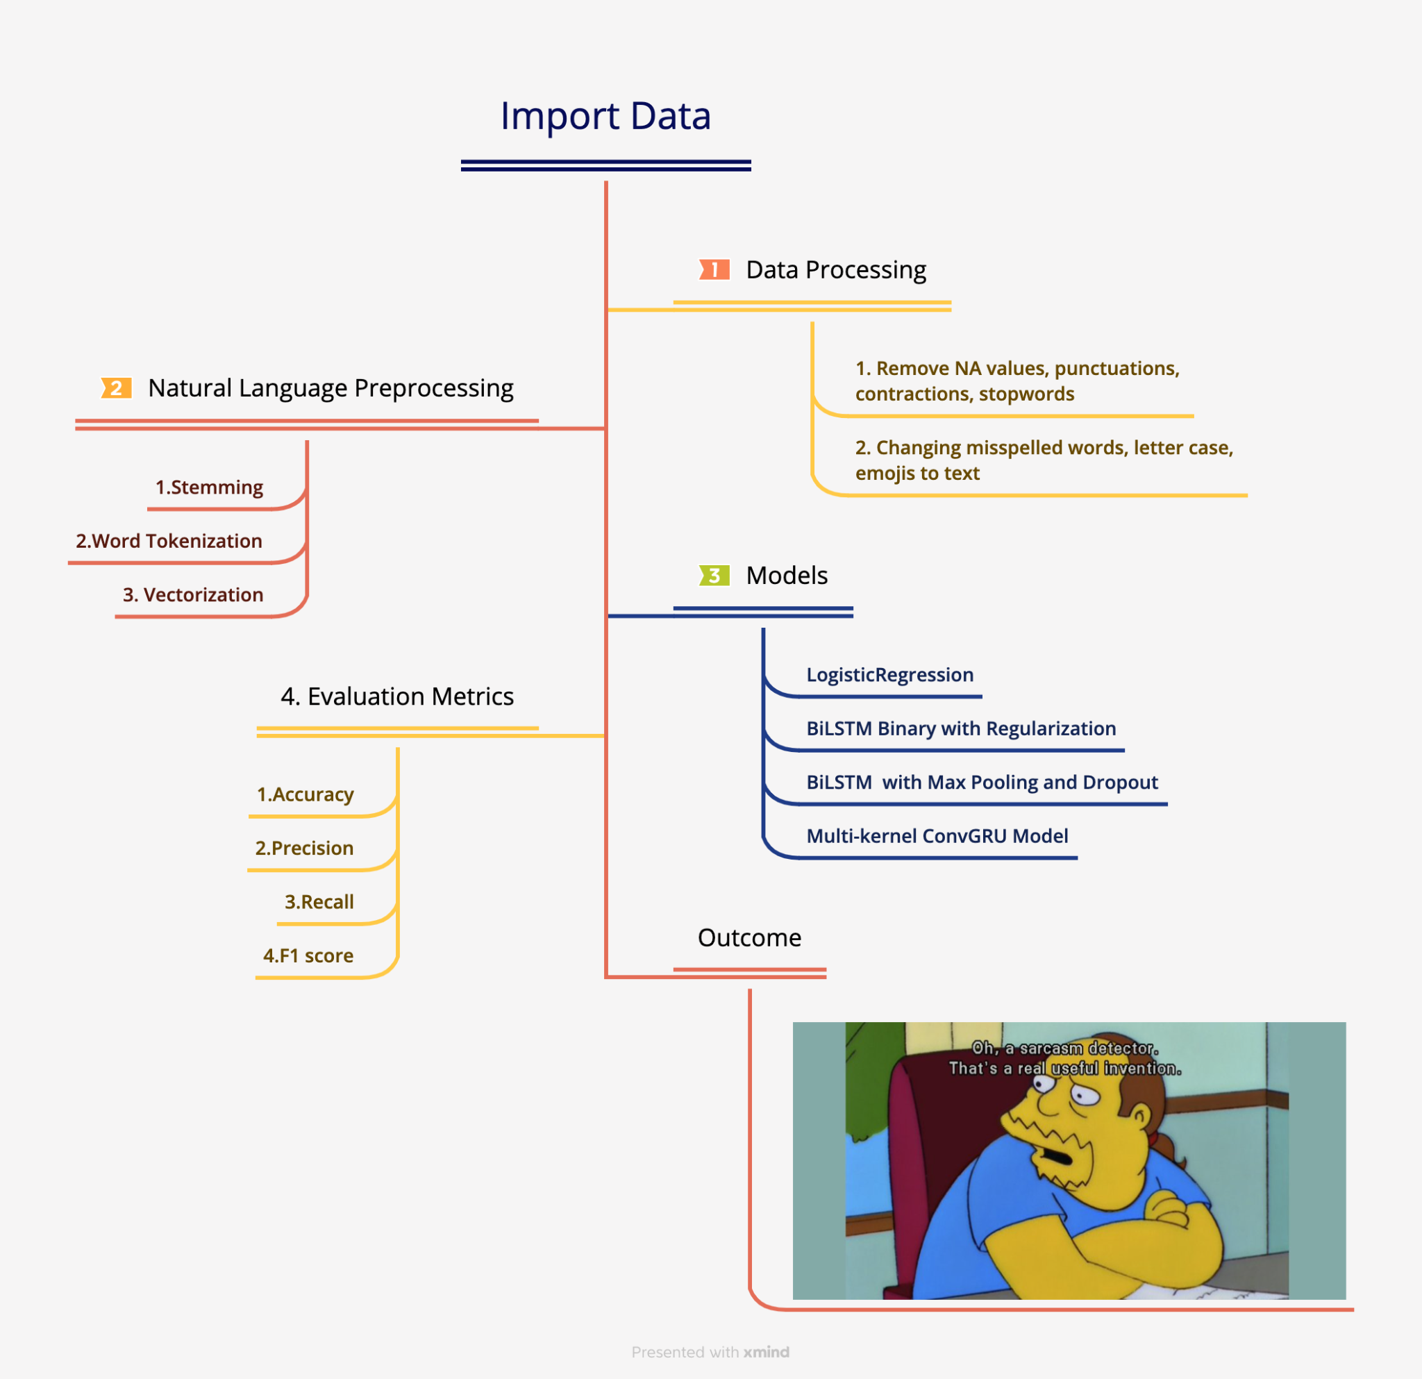

Slide 4
Methodology
Manually Labeled 2,000 random comments
Overall 0.57
0: 0.52, f1-score 0.6
1: 0.55, f1-score 0.44
Train: 1.3M Self-Annotated Reddit Corpus (SARC) (2018)
Test: Manually Labelled
Train Models
Label Problem?
Manually relabelled 2,000 same comments
Overall 0.54
0: 0.54, f1-score 0.55
1: 0.54, f1-score 0.54
Train Models
Still Label Problem?
Re-Literature Review on Sarcasm Dataset
User self-labelled ‘/s’
Notes:
No matter which method we use
Unforseen data

Slide 5
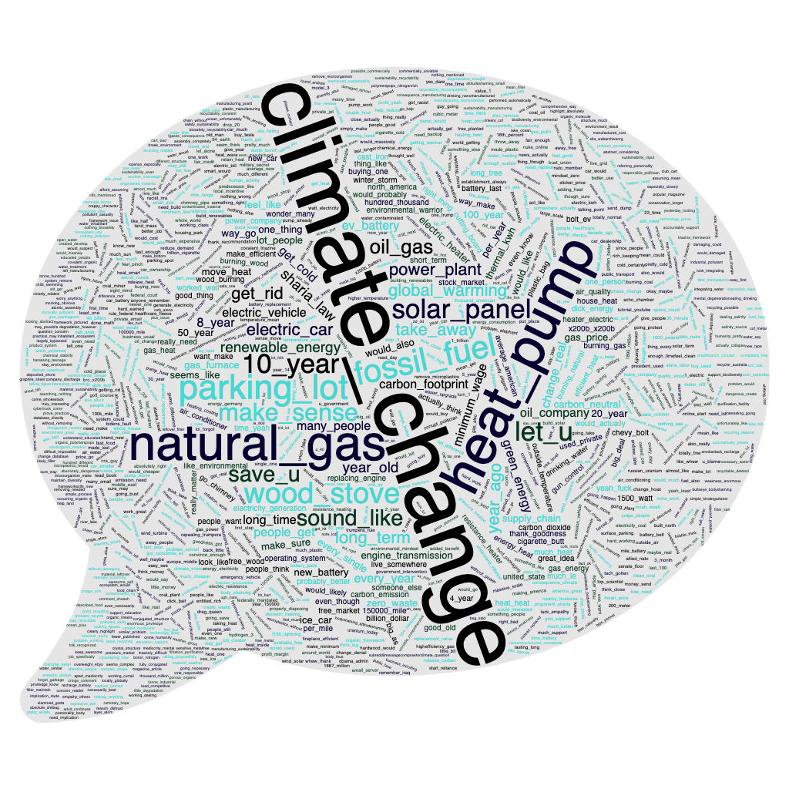
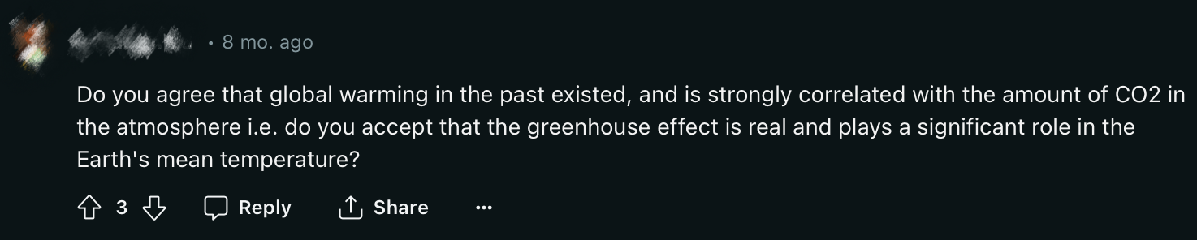
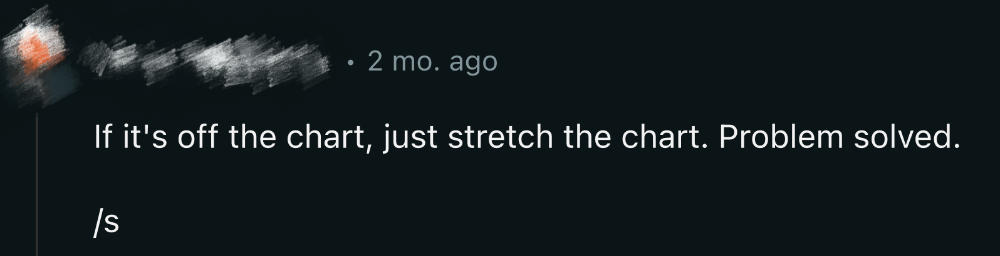
Climate Change Reddit Dataset
“Neutral” Example
“Sarcasm” Example

Slide 6
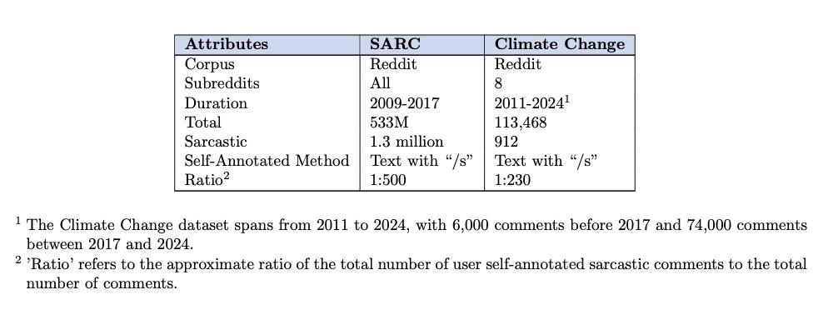
SARC VS Climate Change Reddit Dataset

Slide 7
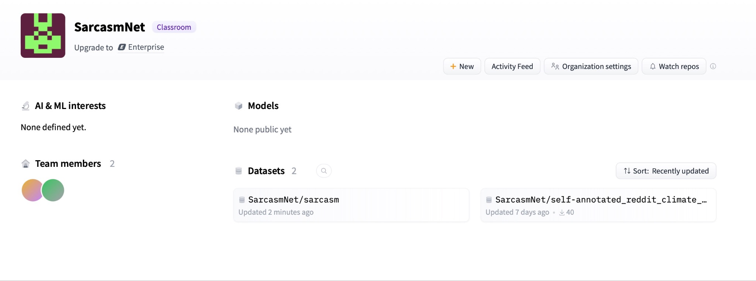
Huggingface Repo

Slide 8
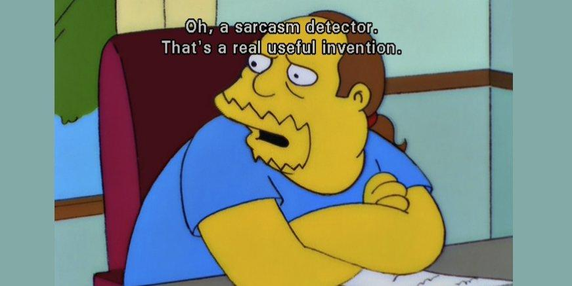
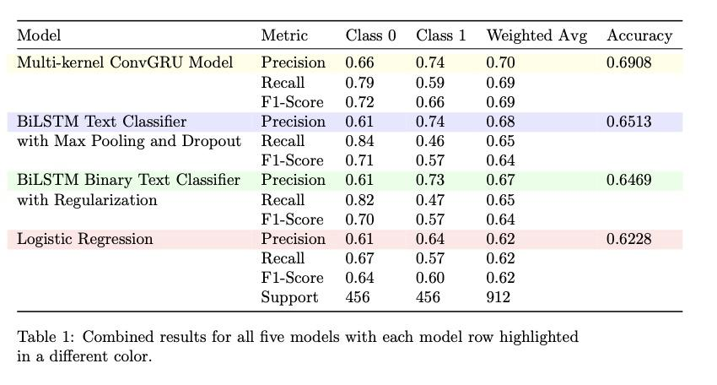
Methodology
Notes:
optimal hyper parameter tuning

Slide 9
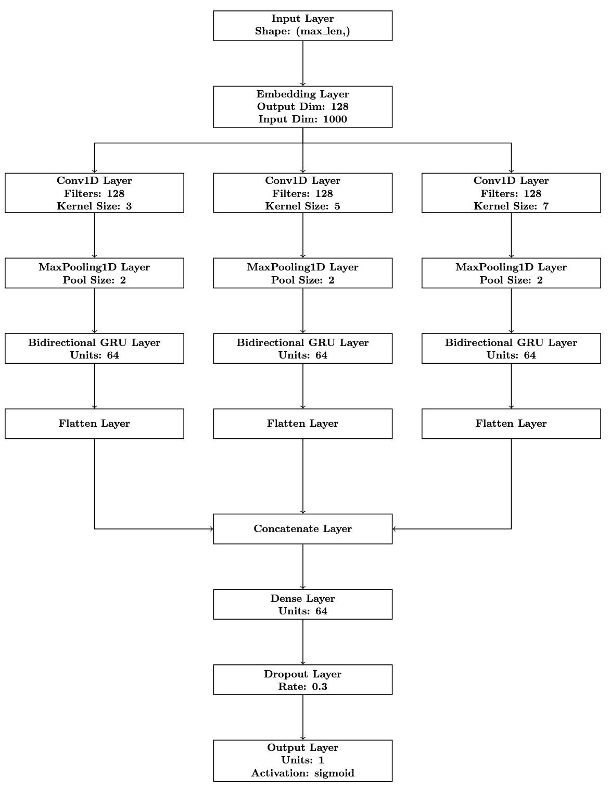
Multi-Kernel Conv-GRU Model
Notes:
Multi-scale Contextual Capture: Using convolutions with different sizes to better understand the input data's details.
Temporal Dependency Learning: A bidirectional GRU layer captures patterns from before and after the current point in time.Feature Integration: Combining outputs from several convolutions with dense layers for more accurate predictions.
Dynamic Temporal Characteristics: Bidirectional GRUs help the model learn from past events and predict future ones, improving its grasp of how sequences change over time.

Slide 10
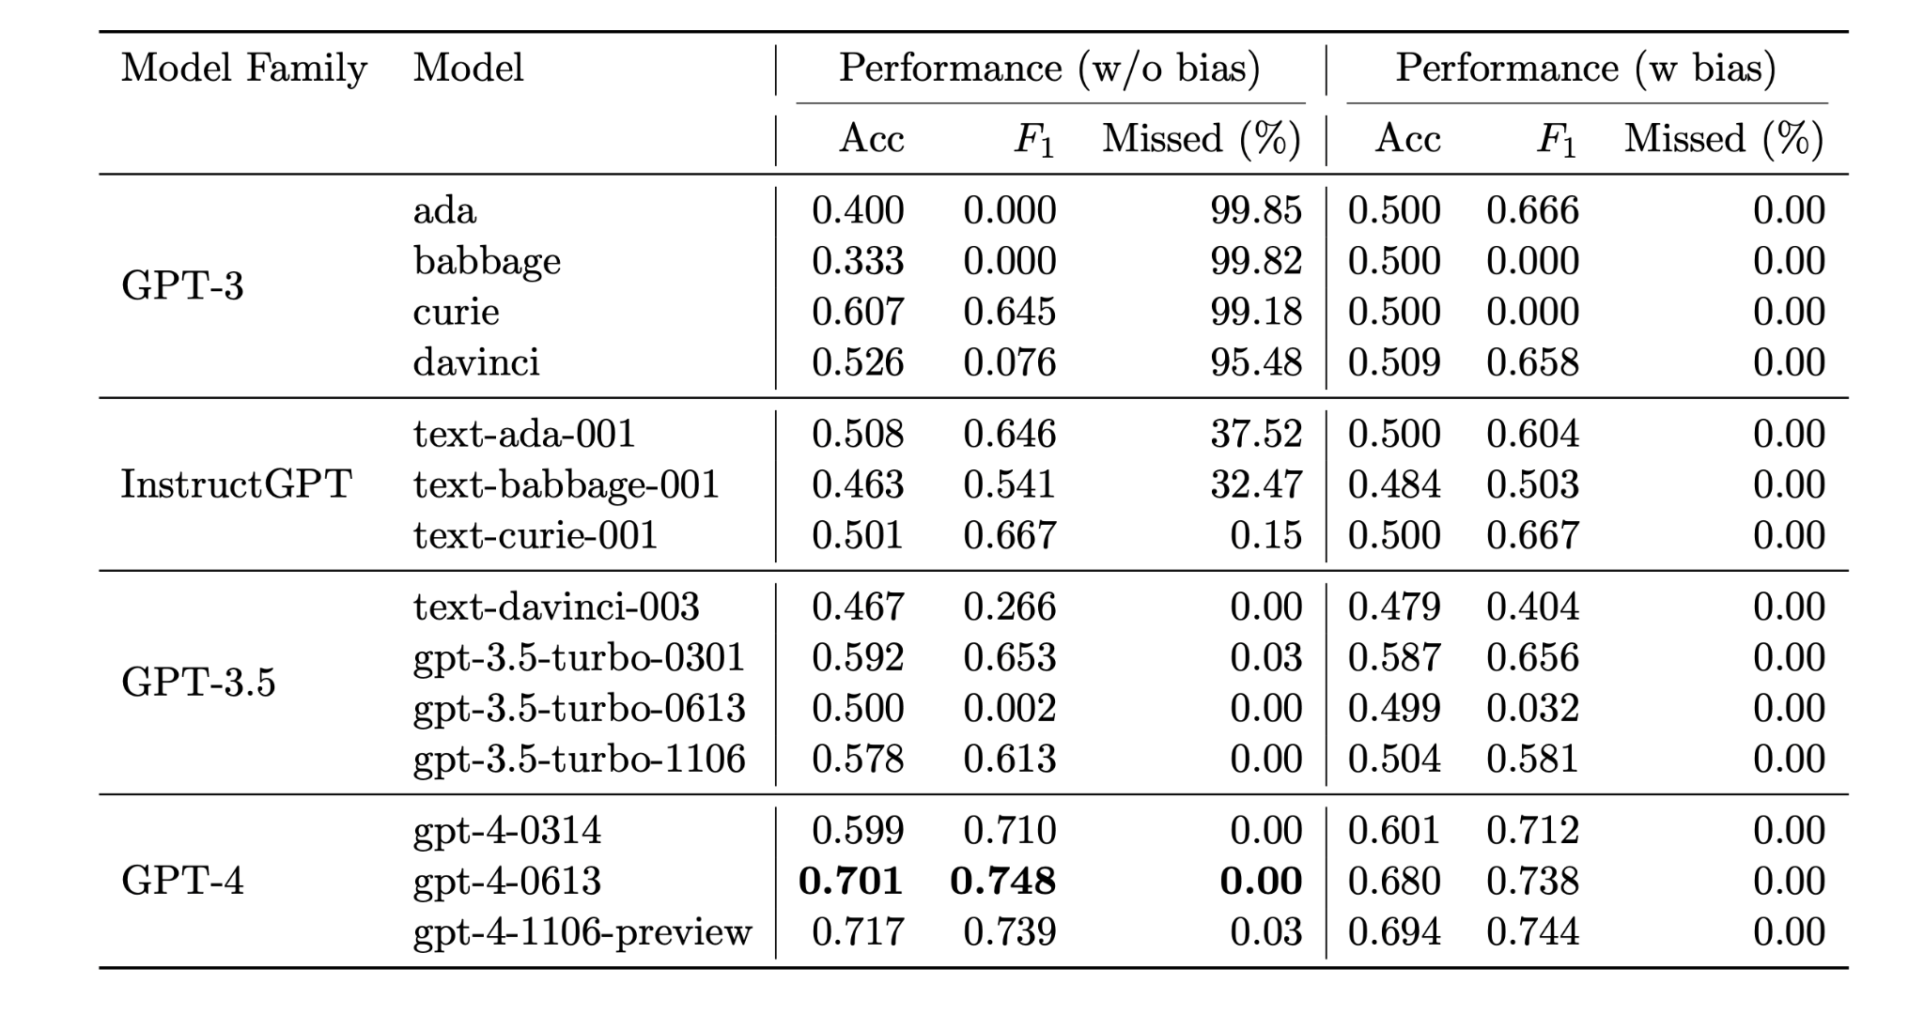
Compare to GPT Detection

Slide 11
Future Work and Limitations
Limited Dataset
Constrained Topics
Temporal and Cultural Variability
Non-standard Cues
Model
Notes:
word2vec

Slide 12
Reference
Khodak, M., Saunshi, N., & Vodrahalli, K. (2018). A Large Self-Annotated Corpus for Sarcasm. In LREC 2018 (pp. 1-6).
Rahman M O, Hossain M S, Junaid T S, et al. Predicting prices of stock market using gated recurrent units (GRUs) neural networks[J]. Int. J. Comput. Sci. Netw. Secur, 2019, 19(1): 213-222.
Yu Y, Si X, Hu C, et al. A review of recurrent neural networks: LSTM cells and network architectures[J]. Neural computation, 2019, 31(7): 1235-1270.
Gole, M., Nwadiugwu, W. P., & Miranskyy, A. (2023). On Sarcasm Detection with OpenAI GPT-based Models.
B. Sonare, J. H. Dewan, S. D. Thepade, V. Dadape, T. Gadge and A. Gavali, "Detecting Sarcasm in Reddit Comments: A Comparative Analysis," 2023 4th International Conference for Emerging Technology (INCET), Belgaum, India, 2023, pp. 1-6, doi: 10.1109/INCET57972.2023.10170613.

Slide 13

THANK YOU!
ANY QUESTION?

